Slide 2
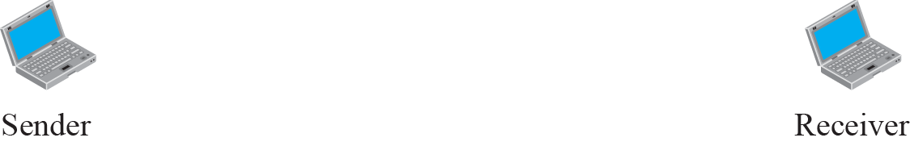

Figure 20.8 Offer to disable an option

Slide 3
Figure 20.9 Request to disable an option

Slide 4
Example 20.1
Figure 20.10 shows an example of option negotiation. In this example, the client wants the serverto echo each character sent to the server. In other words, when a character is typed at the user keyboard terminal, it goes to the server and is sent back to the screen of the user before being processed. The echo option is enabled by the server because it is the server that sends the characters back to the user terminal. Therefore, the client should request from the server the enabling of the option using DO. The request consists of three characters: IAC, DO, and ECHO. The server accepts the request and enables the option. It informs the client by sending the three-character approval: IAC, WILL, and ECHO.

Slide 5
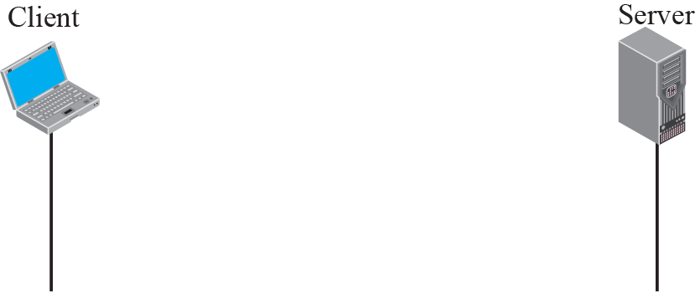
Figure 20.10 Example 20.1: Echo option

Slide 7
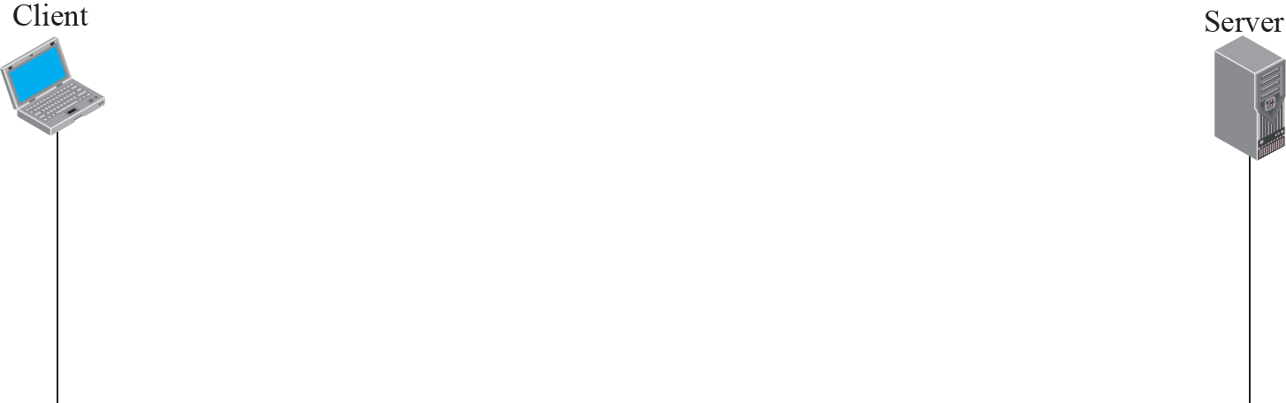
Figure 20.11 Example of sub-option negotiation

Slide 8
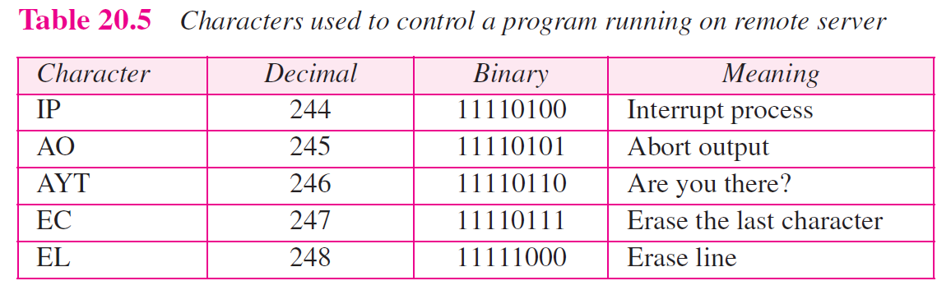

Slide 9
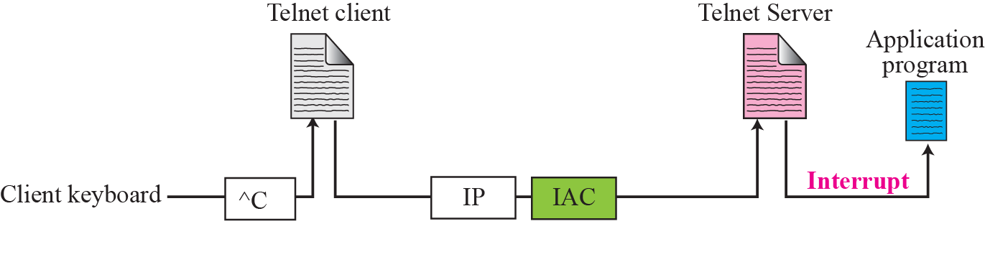
Figure 20.12 Example of interrupting an application program

Slide 10
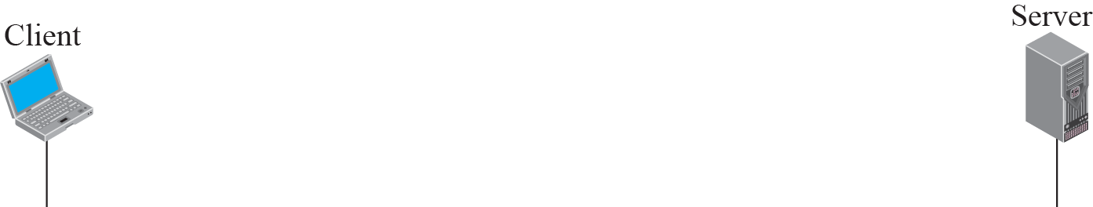
Figure 20.13 Out-of-band signaling

Slide 11
Example 20.2
In this example, we use the default mode to show the concept and its deficiencies even though it is almost obsolete today. The client and the server negotiate the terminal type and terminal speed and then the server checks the login and password of the user (see Figure 20.15).

Slide 12
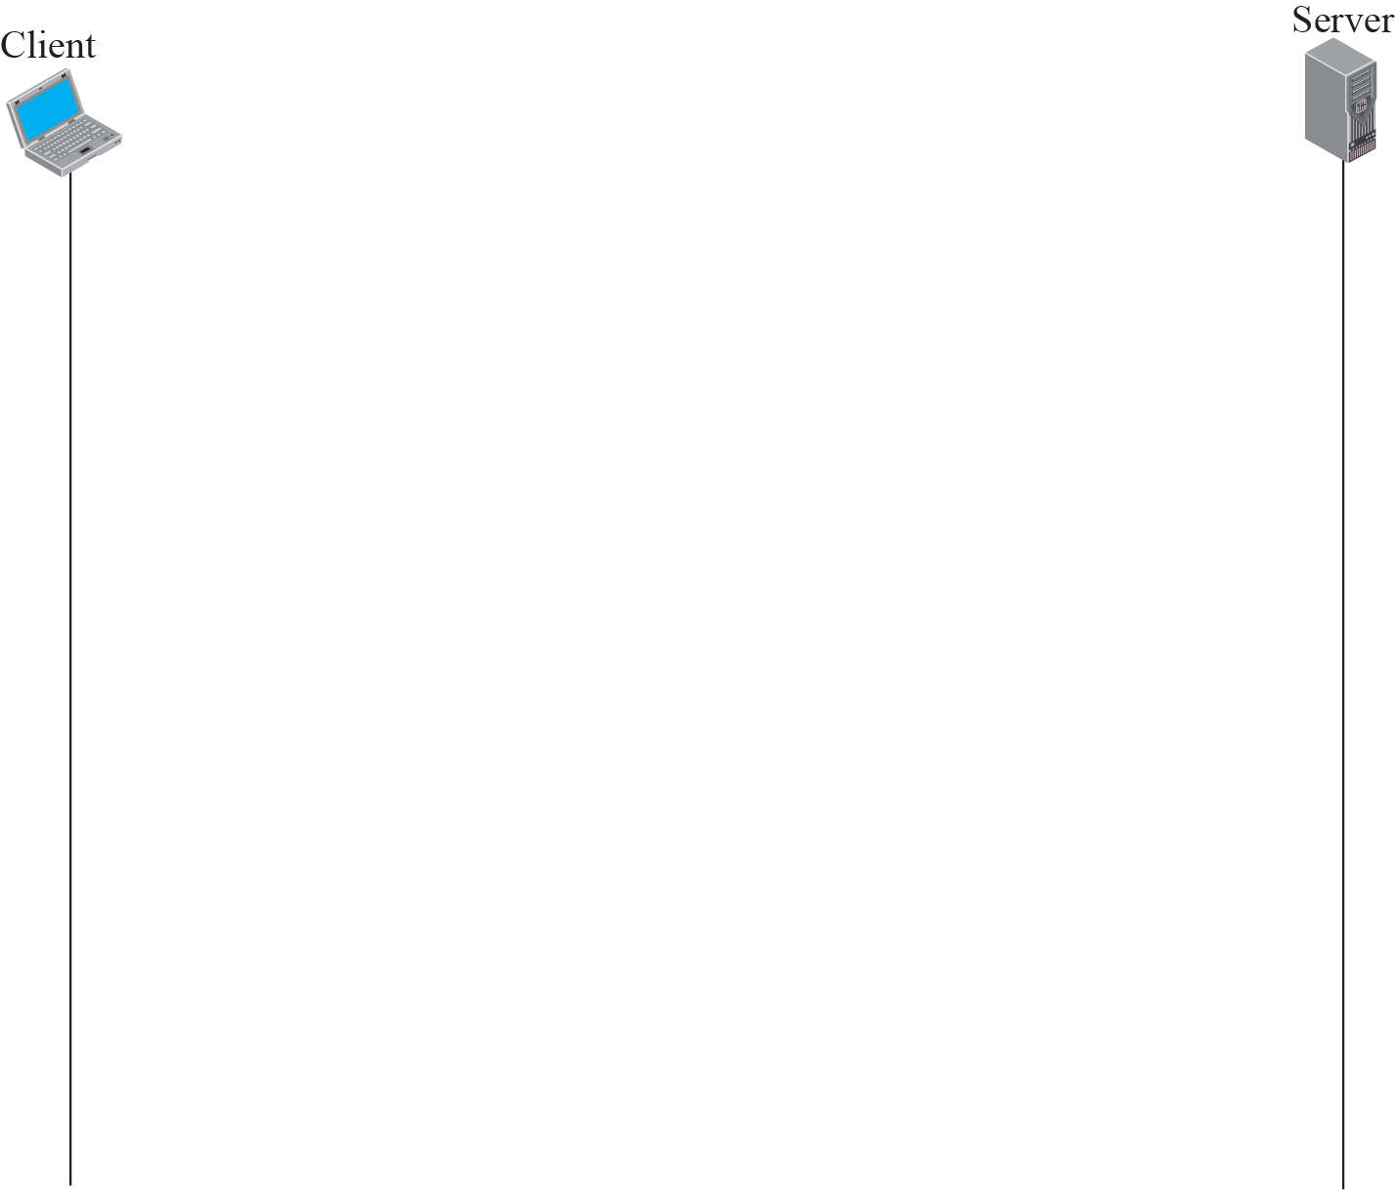
Figure 20.15 Example 20.2

